Slide 1
Computer architecture and Organization Memory Organization

Slide 2
Memory Organization
Memory Hierarchy
Arrangement of different types of memories based on accessibility in computer system
Main Memory: memory unit that communicates directly with the CPU (RAM)
Auxiliary Memory: device that provide backup storage (Disk Drives)
Cache Memory: special very-high-speed memory to increase the processing speed

Slide 3
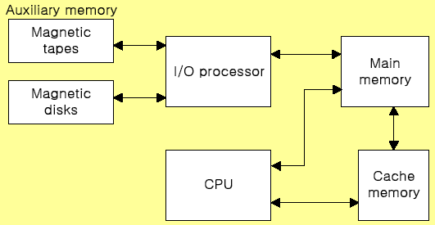
Memory Organization
Memory Hierarchy
Order according to speed: Cache>Main Memory>Auxiliary memory
Order according to size: Cache<Main memory<Auxiliary memory

Slide 4
Memory Organization
Main Memory
Main memory is the only one directly accessible to the CPU.
The CPU continuously reads instructions stored there and executes them as required.
Any data actively operated on is also stored there in uniform manner.
RAM (Random access memory) and ROM (Read only memory) are treated as main memory.

Slide 5
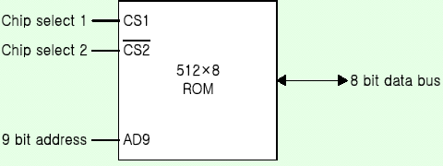
Memory Organization
ROM
Stores a program that helps start up the computer
ROM is non-volatile (holds programs and data even after power off)
ROM is also direct access but only read
The contents of ROM are fixed at the time of manufacture (a typical ROM chip)

Slide 6
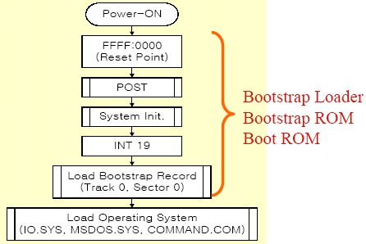
Memory Organization
Bootstrap Loader
A program whose function is to start the computer software operating when power is turned on

Slide 7
Memory Organization
RAM
Its purpose is to temporarily hold programs and data for processing.
Described as being volatile (all data are lost when power off)
It is direct access as it can be both written to or read from in any order

Slide 8
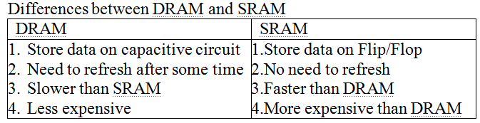
Memory Organization
Types of RAM
Dynamic RAM (DRAM)
The RAM which requires the stored information to be periodically re-written, or refreshed, otherwise it would vanish.
Static RAM (SRAM)
The RAM which never needs to be refreshed as long as power is applied. (It loses its content if power is removed).

Slide 9
Memory Organization
Memory address map
Memory Address Map is a representation of assigned address space for each chip
Assume that a computer system needs 512 bytes of RAM and 512 bytes of ROM
The RAM have 128 byte and need seven address lines, where the ROM have 512 bytes and need 9 address lines

Slide 10
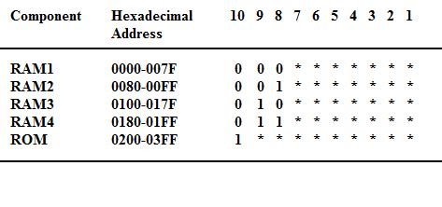
Memory Organization
Memory address map

Slide 11
Memory Organization
Memory Connection with CPU
The hexadecimal address assigns a range of hexadecimal equivalent address for each chip
Line 8 and 9 represent four distinct binary combination to specify which RAM we chose
When line 10 is 0, CPU selects a RAM. And when it’s 1, it selects the ROM

Slide 12
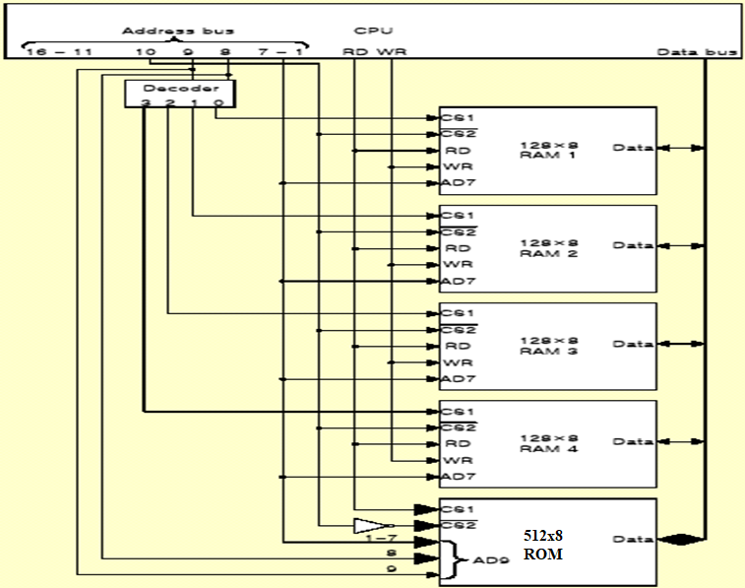
Memory Organization
Memory Connection with CPU

Slide 13
Memory Organization
Cache memory
Small amount of faster memory (SRAM) to speed up computer
Level 1 cache is built within the CPU (internal)
Level 2 cache may be on chip or nearby (external)
Faster for CPU to access than main memory

Slide 14
Memory Organization
Cache performance
Defined as hit ratio
When the CPU refers to memory and finds the word in cache, it is called hit;
If the word is not found in cache it counts miss.
The hit ratio is defined as: hit ratio=hit/(hit+miss).

Slide 15
Memory Organization
Factors of Cache performance
Cache size
Mapping method: associative, direct, set-associative
Replace algorithm: LRU, LFU, FIFO
Write policy: write-through, write-back

Slide 16
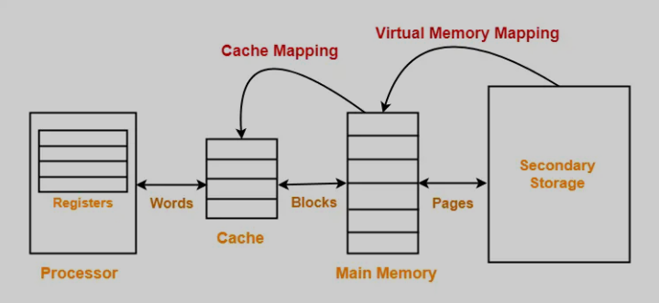
Memory Organization

Slide 17
Memory Organization
Cache Replacement Algorithm
LRU (Least Recently Used)
LFU (Least Frequently Used)
FIFO (First-In First-Out)
Writing to Cache
Write-through: Data is written to both cache and main memory at the same time.
Write-back: Cache write and set flag to indicate the last writing. Memory updated only when cache block is replaced.

Slide 18
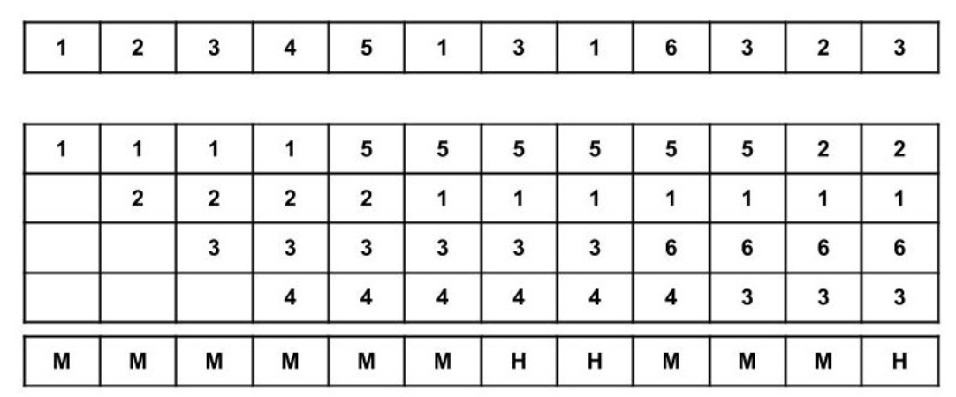
First-In First-Out
Consider the page reference string of size 12: 1, 2, 3, 4, 5, 1, 3,1, 6, 3, 2, 3 with frame size 4(i.e. maximum 4 pages in a frame).

Slide 19
First-In First-Out
Total Page Fault = 9
Page Fault ratio = total miss/total possible cases
Page Fault ratio = 9/12

Slide 20
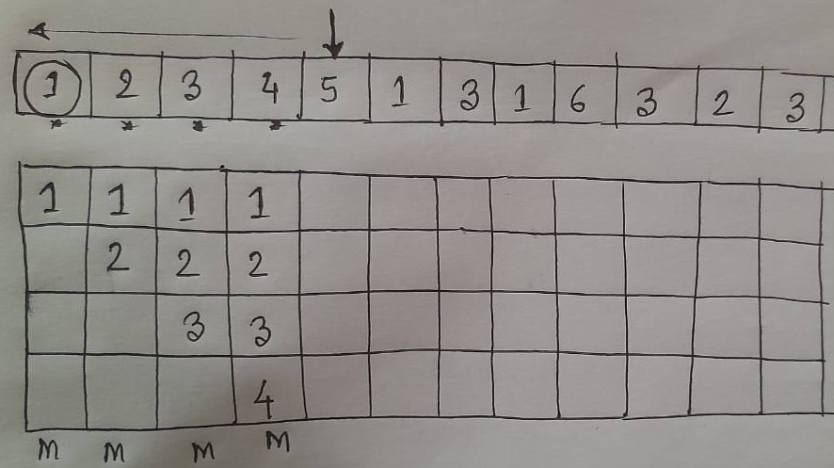
Least Recently Used
Consider the page reference string of size 12: 1, 2, 3, 4, 5, 1, 3,1, 6, 3, 2, 3 with frame size 4(i.e. maximum 4 pages in a frame).

Slide 21
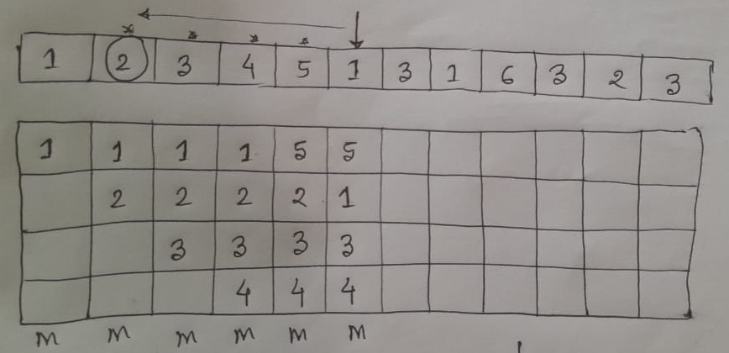
Least Recently Used
Consider the page reference string of size 12: 1, 2, 3, 4, 5, 1, 3,1, 6, 3, 2, 3 with frame size 4(i.e. maximum 4 pages in a frame).

Slide 22
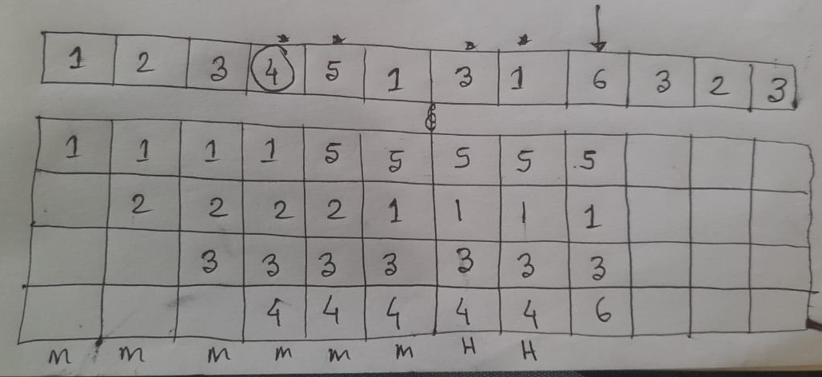
Least Recently Used
Consider the page reference string of size 12: 1, 2, 3, 4, 5, 1, 3,1, 6, 3, 2, 3 with frame size 4(i.e. maximum 4 pages in a frame).

Slide 23
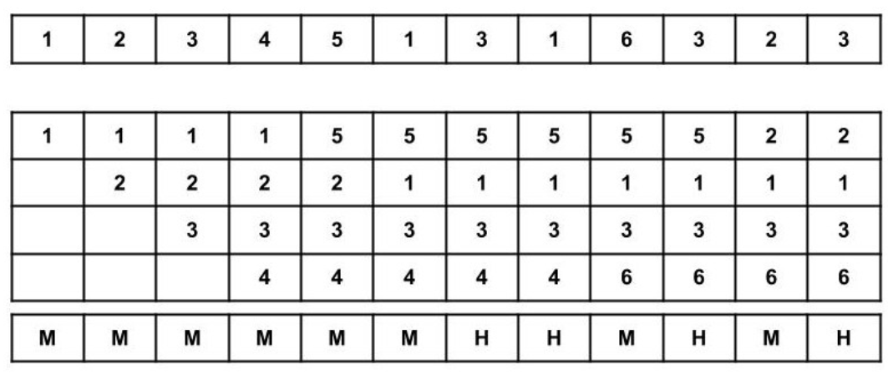
Least Recently Used

Slide 24
Least Recently Used
Total Page Fault = 8
Page Fault ratio = total miss/total possible cases
Page Fault ratio = 8/12

Slide 25
Least Frequently Used
Consider the page reference string of size 10: 3,5,6,6,1,1,4,2,3,4 with frame size 3(i.e. maximum 3 pages in a frame).
3 | 5 | 6 | 6 | 1 | 1 | 4 | 2 | 3 | 4
3 | 3 | 3 | 3 | 1
 | 5 | 5 | 5 | 5
 |  | 6 | 6 | 6
M | M | M | H | M
 | 3 | 5 | 6 | 1 | 4 | 2
Freq. | 1 | 1 | 2 | 0 /1 | 0 | 0

Slide 26
Least Frequently Used
Consider the page reference string of size 10: 3,5,6,6,1,1,4,2,3,4 with frame size 3(i.e. maximum 3 pages in a frame).
3 | 5 | 6 | 6 | 1 | 1 | 4 | 2 | 3 | 4
3 | 3 | 3 | 3 | 1 | 1 | 1
 | 5 | 5 | 5 | 5 | 5 | 4
 |  | 6 | 6 | 6 | 6 | 6
M | M | M | H | M | H | M
 | 3 | 5 | 6 | 1 | 4 | 2
Freq. | 0 | 1 | 2 | 1/2 | 0 | 0

Slide 27
Least Frequently Used
Consider the page reference string of size 10: 3,5,6,6,1,1,4,2,3,4 with frame size 3(i.e. maximum 3 pages in a frame).
3 | 5 | 6 | 6 | 1 | 1 | 4 | 2 | 3 | 4
3 | 3 | 3 | 3 | 1 | 1 | 1 | 1
 | 5 | 5 | 5 | 5 | 5 | 4 | 2
 |  | 6 | 6 | 6 | 6 | 6 | 6
M | M | M | H | M | H | M | M
 | 3 | 5 | 6 | 1 | 4 | 2
Freq. | 0 | 0 | 2 | 2 | 0/1->0 | 0->1

Slide 28
Least Frequently Used
Consider the page reference string of size 10: 3,5,6,6,1,1,4,2,3,4 with frame size 3(i.e. maximum 3 pages in a frame).
3 | 5 | 6 | 6 | 1 | 1 | 4 | 2 | 3 | 4
3 | 3 | 3 | 3 | 1 | 1 | 1 | 1 | 1
 | 5 | 5 | 5 | 5 | 5 | 4 | 2 | 3
 |  | 6 | 6 | 6 | 6 | 6 | 6 | 6
M | M | M | H | M | H | M | M | M
 | 3 | 5 | 6 | 1 | 4 | 2
Freq. | 0+1 | 0 | 2 | 2 | 0 | 1->0

Slide 29
Least Frequently Used
Consider the page reference string of size 10: 3,5,6,6,1,1,4,2,3,4 with frame size 3(i.e. maximum 3 pages in a frame).
3 | 5 | 6 | 6 | 1 | 1 | 4 | 2 | 3 | 4
3 | 3 | 3 | 3 | 1 | 1 | 1 | 1 | 1 | 1
 | 5 | 5 | 5 | 5 | 5 | 4 | 2 | 3 | 4
 |  | 6 | 6 | 6 | 6 | 6 | 6 | 6 | 6
M | M | M | H | M | H | M | M | M | M
 | 3 | 5 | 6 | 1 | 4 | 2
Freq. | 1->0 | 0 | 2 | 2 | 0+1 | 0

Slide 30
Least Frequently Used
Total Page Fault = 8
Page Fault ratio = total miss/total possible cases
Page Fault ratio = 8/10

Slide 31
Memory Organization
Secondary Storage
Secondary storage (auxiliary storage) is not directly accessible by the CPU.
The computer usually uses its I/O channels to access secondary storage
Transfers the desired data using intermediate area in primary storage.
Secondary storage does not lose data when the device is powered off - non-volatile.

Slide 32
Memory Organization
Virtual Memory
Uses backing storage e.g. hard disk as a temporary location for programs and data where insufficient RAM available
Swaps programs and data between the hard-disk and RAM as the CPU requires them for processing
A cheap method of running large or many programs on a computer system
Cost is speed: the CPU can access RAM in nanoseconds but hard-disk in milliseconds
Virtual memory is much slower than RAM

Slide 33
Memory Organization
Memory Management
Collection of hardware and software for managing the various programs residing in memory.
The basic components of a memory management unit are:
A facility for dynamic storage relocation that maps logical memory references into physical memory addresses
A provision for sharing common programs stored in memory by different users
Protection of information against unauthorized access between users and preventing users from changing operating systems functions.

Slide 34
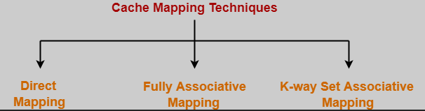
Memory Organization
Cache mapping techniques

Slide 35
Memory Organization
Direct Mapping
A particular block of main memory can map only to a particular line of the cache.
The line number of cache to which a particular block can map is given by-
Cache line number= ( Main Memory Block Address ) Modulo (Number of lines in Cache)

Slide 36
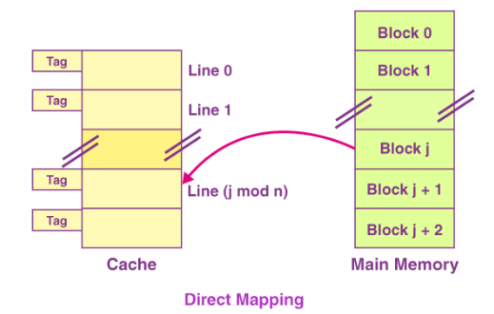
Memory Organization
Direct Mapping
Consider cache memory
is divided into ‘n’
number of lines.
Then, block ‘j’ of main
memory can map to line
number (j mod n) only of
the cache.

Slide 37
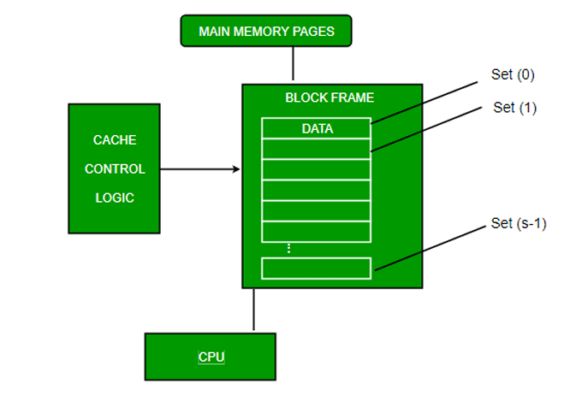
Memory Organization

Slide 38
Memory Organization
In direct mapping,
There is no need of any replacement algorithm.
This is because a main memory block can map only to a particular line of the cache.
Thus, the new incoming block will always replace the existing block (if any) in that particular line.

Slide 39
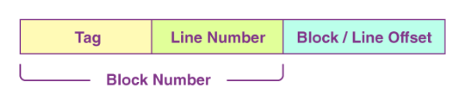
Memory Organization
Division of Physical Address
physical address is the actual hardware-level location in the computer's main memory (RAM).

Slide 40
Memory Organization
Division of Physical Address
MM Size: 4 GB
Cache Size: 1 MB
Block Size: 4 KB
P.A. bits split?
Tag directory size?

Slide 41
Memory Organization
Division of Physical Address
MM Size = 4 GB = 2²×2³⁰B = 2⁽²⁺³⁰⁾B = 2³²B
∴ No. of P.A. bits = log⁡₂2³²=32

Slide 42
Memory Organization
Division of Physical Address
Block Size = 4 KB = 2²×2¹⁰B = 2¹²B [Block offset=12 bits]
No. of Blocks in MM = 2³²/2¹²=2²⁰
∴ Block number bits = log₂2²⁰=20

Slide 43
Memory Organization
Division of Physical Address
Cache Size = 1 MB = 1×2²⁰B = 2²⁰ B
No. of Lines in Cache = 2²⁰/2¹² = 2⁸
∴ Line number bits = log⁡₂2⁸=8
No. of Tag bits: P.A. bits − (Line no. bits + offset) = 32−(8+12)
=12bits

Slide 44
Memory Organization
Fully Associative Mapping
In fully associative mapping,
A block of main memory can map to any line of the cache that is freely available at that moment.
This makes fully associative mapping more flexible than direct mapping.

Slide 45
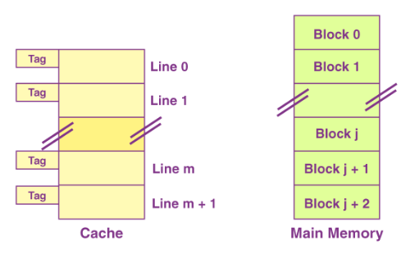
Memory Organization
Fully Associative Mapping
All the lines of cache
are freely available.
Thus, any block of main
memory can map to any
line of the cache.
Had all the cache lines been
occupied, then one of the
existing blocks will have to
be replaced

Slide 46
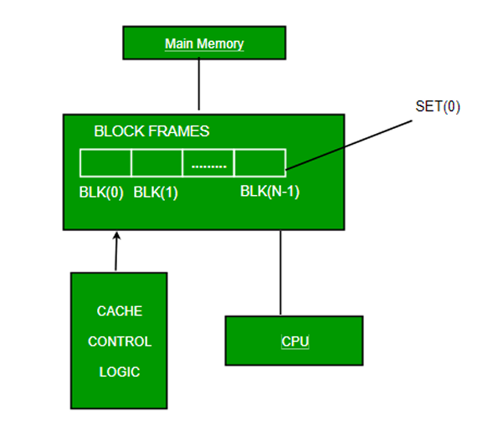
Memory Organization
Fully Associative Mapping

Slide 47
Memory Organization
Need of Replacement Algorithm
In fully associative mapping,
A replacement algorithm is required.
Replacement algorithm suggests the block to be replaced if all the cache lines are occupied.
Thus, replacement algorithm like FCFS Algorithm, LRU Algorithm etc is employed.

Slide 48

Memory Organization
Division of Physical Address-
In fully associative mapping, the physical address is divided as-

Slide 49
Memory Organization
Example 01:Consider a fully associative mapped cache of size 16 KB with block size 256 bytes. The size of main memory is 128 KB. Find-
a. Number of bits in tag
b. Tag directory size

Slide 50
Memory Organization
Example:02 Consider a fully associative mapped cache of size 512 KB with block size 1 KB. There are 17 bits in the tag. Find-
a. Size of main memory
b. Tag directory size

Slide 51
Memory Organization
K-way Set Associative Mapping
In k-way set associative mapping,
Cache lines are grouped into sets where each set contains k number of lines.
A particular block of main memory can map to only one particular set of the cache.
However, within that set, the memory block can map any cache line that is freely available.
The set of the cache to which a particular block of the main memory can map is given by-
Cache set number= ( Main Memory Block Address ) Modulo (Number of sets in Cache)

Slide 52
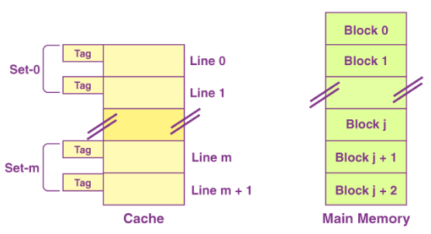
Memory Organization
K-way Set Associative Mapping
k = 2 suggests that each
set contains two cache
lines.
Since cache contains 6 lines,
so number of sets in the
cache = 6 / 2 = 3 sets.
Block ‘j’ of main memory can
map to set number (j mod 3) only
of the cache.
Within that set, block ‘j’ can map
to any cache line that is freely
available at that moment.
If all the cache lines are occupied, then one of the existing blocks will have to be replaced.

Slide 53
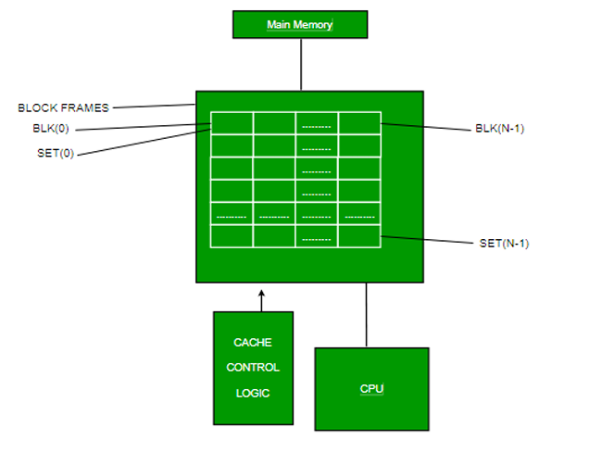
Memory Organization
K-way Set Associative Mapping

Slide 54
Memory Organization
Need of Replacement Algorithm-
Set associative mapping is a combination of direct mapping and fully associative mapping.
It uses fully associative mapping within each set.
Thus, set associative mapping requires a replacement algorithm.

Slide 55

Memory Organization
Division of Physical Address
In set associative mapping, the physical address is divided as-
Special Case: If k = 1, then k-way set associative mapping becomes direct mapping

